Slide 1
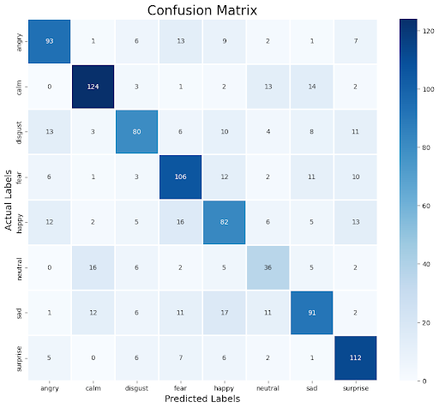

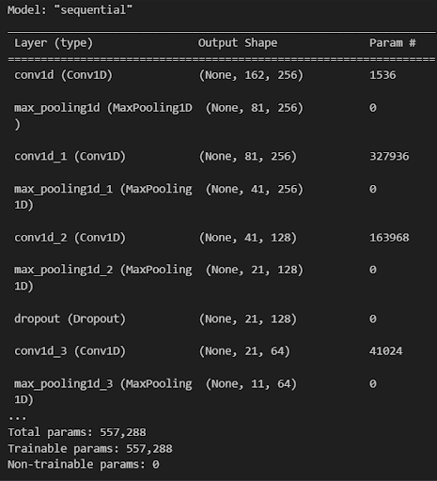
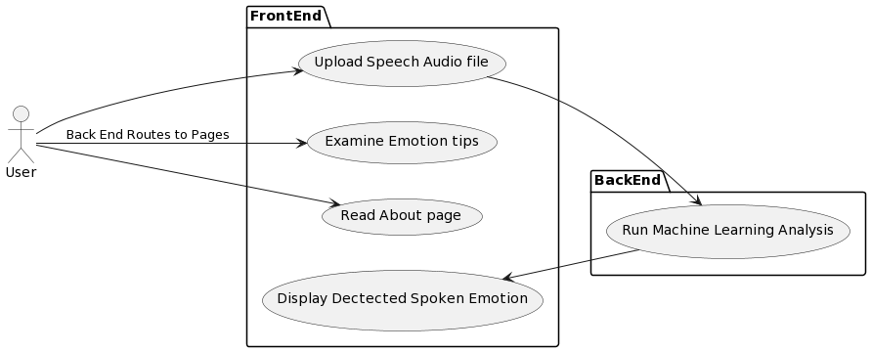
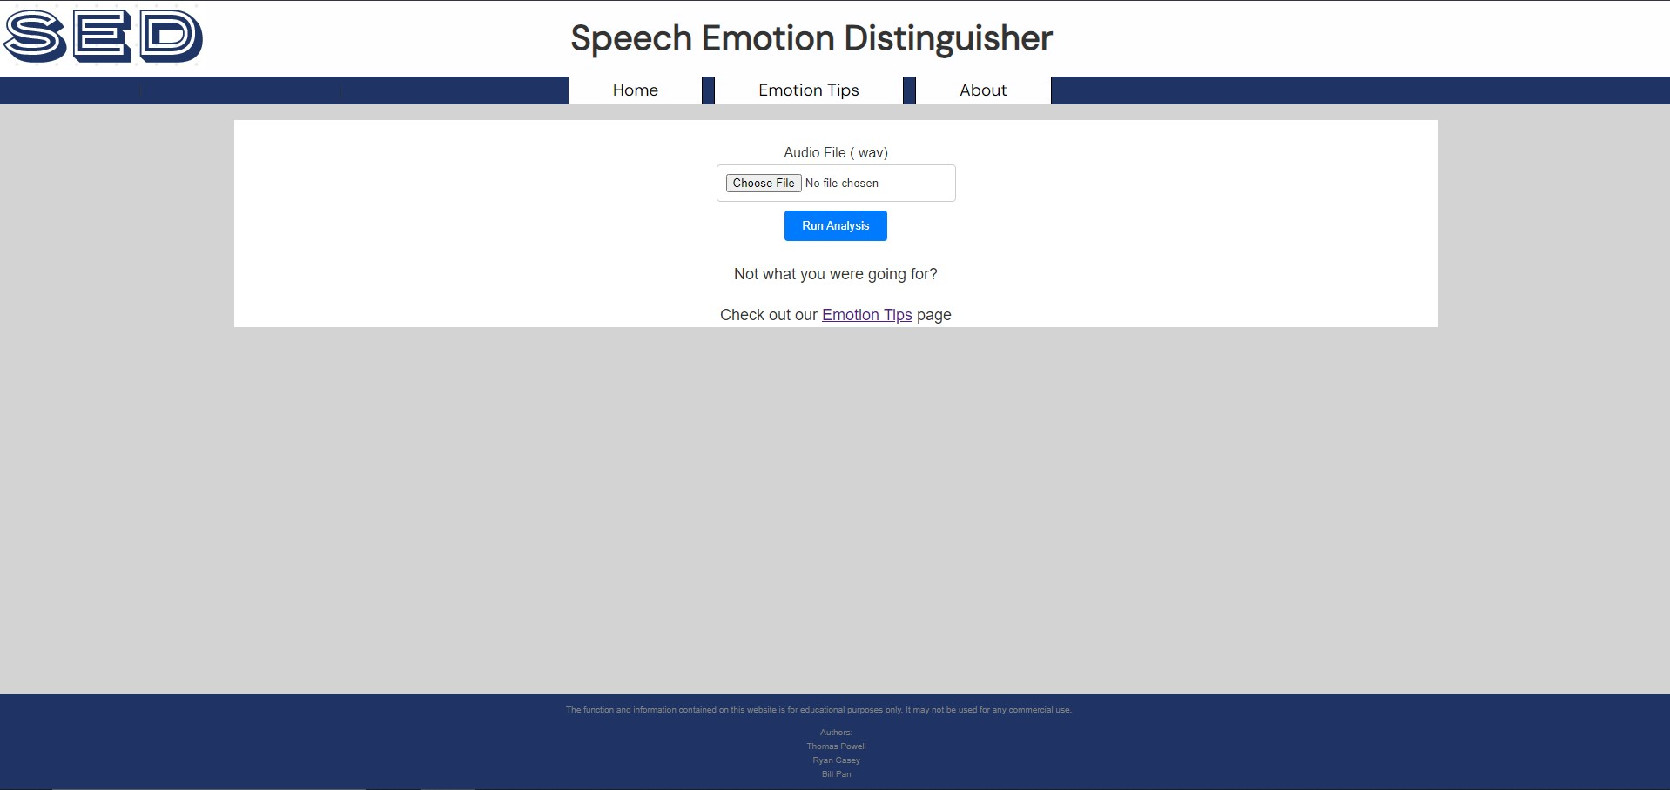
Speech Emotion Distinguisher
Thomas Powell, Ryan Casey, Bill Pan
Advisor: Prof. Umar Albalawi, Ph.D.
School of Computing and Data Science
Wentworth Institute of Technology
Abstract
Design
Implementation
Results
SED is a newly-designed website equipped with an embedded machine-learning model used to predict emotion in speech and provide tips in order to improve emotion in speech. The focus of the project was to design and implement a web hub in order to help people produce and understand emotion in speech.
Front-end
Header
Contains a navigation to the webpages along with logo and title
Home Screen/Analyzer
The main webpage of the website, houses the Speech Emotion Distinguisher form
Communicates directly with machine-learning back-end by obtaining input and displaying output
Emotion Tips
Secondary webpage, displays information and tips on how to achieve a desired emotion while speaking
Displays useful YouTube videos on how to act a certain emotion
About/Footer
Tertiary webpage, displays information about project and authors
Back-end
Contains the preprocessing necessary for the user input to be predicted on by the model
Controls the routing between webpages
.
Front-end design: Website
HTML with CSS styling
Hosting the website on the internet
Using Flask server for hosting
Back-end design: Flask
Flask-based Python app with embedded machine learning model
Implementing necessary input preprocessing for machine learning model prediction
Used Flask app for preprocessing and housing trained scalar, encoder and model.
Data Analysis: Machine Learning Model
Convolution Neural Network trained on the RAVDESS database
Constructing a model that delivered high accuracy and low runtime
Used Keras' package to construct a multi-layer, sequential neural network. Exported model for use on website
Eight classes for classification yields approximately 70% testing accuracy
Figure1: Website Logo
Introduction
Table1: Testing Confusion Matrix
The Speech Emotion Distinguisher or SED is a website aiming to be a hub for understanding, learning and achieving accurate information, exceptional performance abilities, and expansive knowledge in the realm of emotion in speech.
Conclusions
In conclusion, the Speech Emotion Distinguisher represent a major achievement in the field of embedded neural networks and spoken emotion analysis. It enables users to delve into the emotional content of speech. The hard part, however, is to recognize its ability to be used in special education, acting and voice acting and public speaking.
Bibliography
RAVDESS Database https://www.kaggle.com/datasets/uwrfkaggler/ravdess-emotional-speech-audio
Adapted From: https://www.kaggle.com/code/shivamburnwal/speech-emotion-recognition
Figure2: Use Case
Figure3: Website Home Screen/ Speech Emotion Analyzer
Figure4: Convolution Neural Network Model Summary

